Slide 1

SHOPIFY CASE STUDY -SRUTHIKA GUDIPATI -AP22110010207

Slide 2
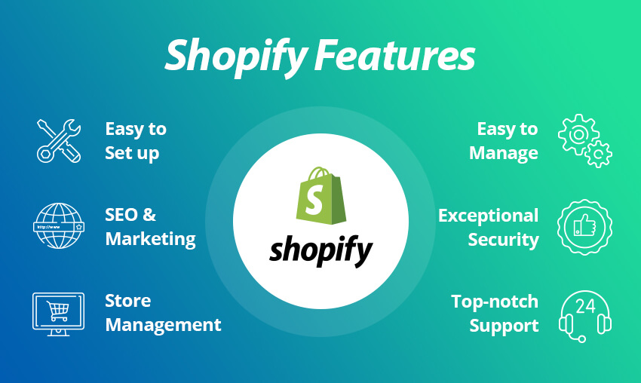

Slide 3
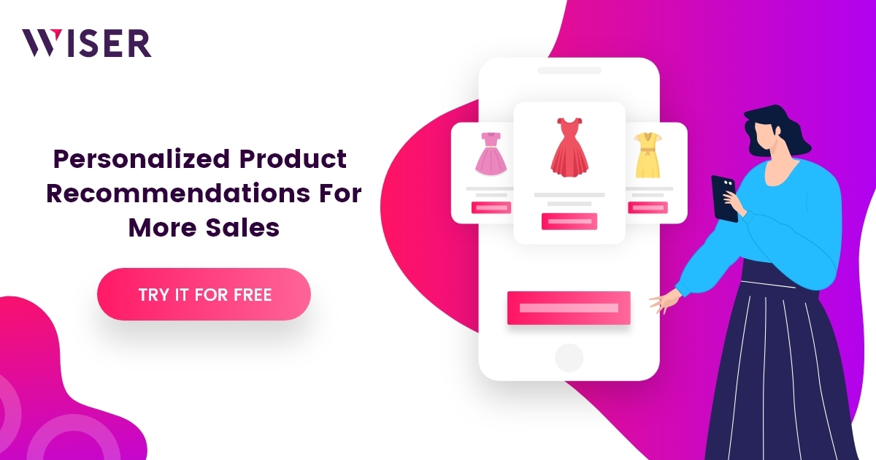
WHAT ARE
RECOMMENDER SYSTEMS
OF SHOPIFY ?
. Product Recommendations for Customers
Collaborative Filtering:
Shopify can recommend products based on the buying and browsing patterns of similar users. If a user frequently views products that other customers have also viewed or purchased together, the platform can suggest those items.
For example, if many customers who bought a particular smartphone case also bought a screen protector, the system could recommend the screen protector to future users purchasing that case.
Content-Based Filtering:
Recommends products based on specific attributes (e.g., color, size, category, brand). Shopify can analyze product attributes and customer preferences to make recommendations, especially useful for new users without much historical data.
For instance, if a customer has shown interest in “organic skincare” products, the system can recommend other items tagged with "organic" and "skincare."
Hybrid Approach:
A blend of collaborative and content-based filtering for more personalized recommendations. For instance, Shopify can suggest products based on both similar users’ behavior and the attributes of products a customer has previously viewed or bought.

Slide 4
TYPES OF RECOMMENDER SYSTEMS:
-> CONTENT BASED FILTERING
-> COLLEBORATIVE BASED FILTERING

Slide 5
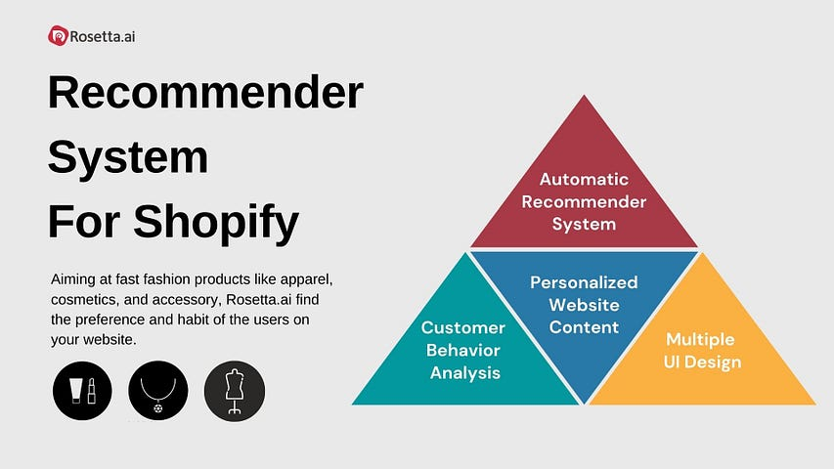
CONTENT- BASED FILTERING
Content-based filtering on Shopify uses product attributes and user behavior to make personalized recommendations. This approach matches users with items based on their preferences, focusing on the specific characteristics of products a user has shown interest in (e.g., browsing, favoriting, or purchasing). Here’s an overview of how content-based filtering can be implemented and optimized on Shopify:
1. Utilizing Product Attributes for Recommendations
Product Descriptions and Tags: Each product on Shopify includes attributes such as description, category, tags, brand, price, material, color, and style. Content-based filtering uses these attributes to suggest items similar to those a user has engaged with. For instance, if a user views "organic skincare" products, other items with the tags "organic" and "skincare" are more likely to be recommended.
Keyword Extraction from Descriptions: Shopify can analyze product descriptions to extract relevant keywords or phrases using natural language processing (NLP). This helps the system recommend products with similar keywords, even if they don't share exact tags or categories.
2. User Profiling Based on Interaction History
Browsing and Purchase History: Shopify can build a profile based on a user’s interaction history, such as items they’ve viewed, added to their cart, or purchased. This profile reflects the user's preference for certain attributes (e.g., a preference for cotton material or specific brands).
Attribute-Based Preference Modeling: For example, if a user frequently views products in "sportswear" or "athleisure" categories, Shopify can recommend new items that match these preferences, even if they are from different brands or styles.

Slide 6
3. Text and Image Analysis for Detailed Product Features
Text-Based Filtering with NLP: NLP techniques, such as TF-IDF or word embeddings (Word2Vec, BERT), can be used to analyze product titles and descriptions, helping the system identify products with similar themes or characteristics. This allows Shopify to recommend products based on nuanced descriptions (e.g., recommending “vegan leather” bags to users interested in "sustainable fashion").
Image Recognition for Visual Similarity: Shopify can use computer vision to analyze product images and recommend visually similar items. For instance, if a user is looking at floral-patterned dresses, image recognition can suggest other products with similar patterns, colors, or shapes.
4. Real-Time Recommendations Based on Current Session Data
Session-Based Filtering: Content-based filtering can be applied to a user’s current session to recommend products in real-time. If a user browses multiple products within a specific category, Shopify can dynamically adjust recommendations to reflect that category.
Feature Weighting in Real-Time: Shopify can assign more weight to attributes that a user has shown immediate interest in. For example, if they’re currently looking at eco-friendly products, Shopify could prioritize attributes related to sustainability or ethical sourcing in real-time recommendations.
5. Custom Collections and Category Recommendations
Personalized Collections: Shopify can use content-based filtering to create custom collections for users based on their previous interactions. For example, if a user regularly buys skincare products, they might see a recommended collection called "Curated Skincare for You" on their homepage.
Category-Level Recommendations: For users frequently browsing specific categories (e.g., “Home Decor” or “Winter Wear”), Shopify can recommend popular or new items within those categories, even without relying on collaborative filtering from other users.
6. Cross-Attribute Recommendations
Content-based filtering allows Shopify to recommend products that combine attributes from multiple previously viewed items. For example, if a user has shown interest in both “denim jackets” and “oversized fits,” the system can recommend oversized denim jackets or other oversized clothing items.
Attribute Expansion for Variety: Shopify can expand attribute matching to suggest related items (e.g., if a user likes a certain color, the system can recommend items in similar tones across different categories).

Slide 7
HERE IS AN EXAMPLE OF CONTENT BASED FILTERING
Scenario: Personalized Recommendations for an Organic Skincare Enthusiast
User Interaction:
A customer, let's call her Anna, is browsing a Shopify store for skincare products. She views and adds to her wishlist items with attributes like "organic," "natural ingredients," "cruelty-free," and "vegan." She specifically looks at products such as Organic Rose Facial Oil, Natural Aloe Vera Gel, and Vegan Vitamin C Serum.
User Profile Creation:
Based on her browsing and wishlist activity, Shopify’s content-based recommendation system identifies her interest in skincare products with specific attributes:
Categories: Skincare, facial treatments
Tags/Attributes: Organic, natural ingredients, cruelty-free, vegan
Product Types: Serums, oils, gels
Generating Recommendations:
Using these product attributes, Shopify recommends similar products with overlapping characteristics. Recommendations for Anna might include:
Organic Avocado Night Cream
Natural Green Tea Face Mist
Cruelty-Free Collagen Boost Serum
Each recommended product is selected based on matching attributes (like "organic" and "cruelty-free") with the items Anna has shown interest in.
Expanding Recommendations with Related Attributes:
Shopify’s system may also suggest items from broader or related categories to introduce some variety. For instance, since Anna is interested in organic skincare, Shopify might recommend:
Organic Lip Balm (related skincare item)
Natural Hair Oil (cross-category but matches her "organic" and "natural ingredients" preference)

Slide 8
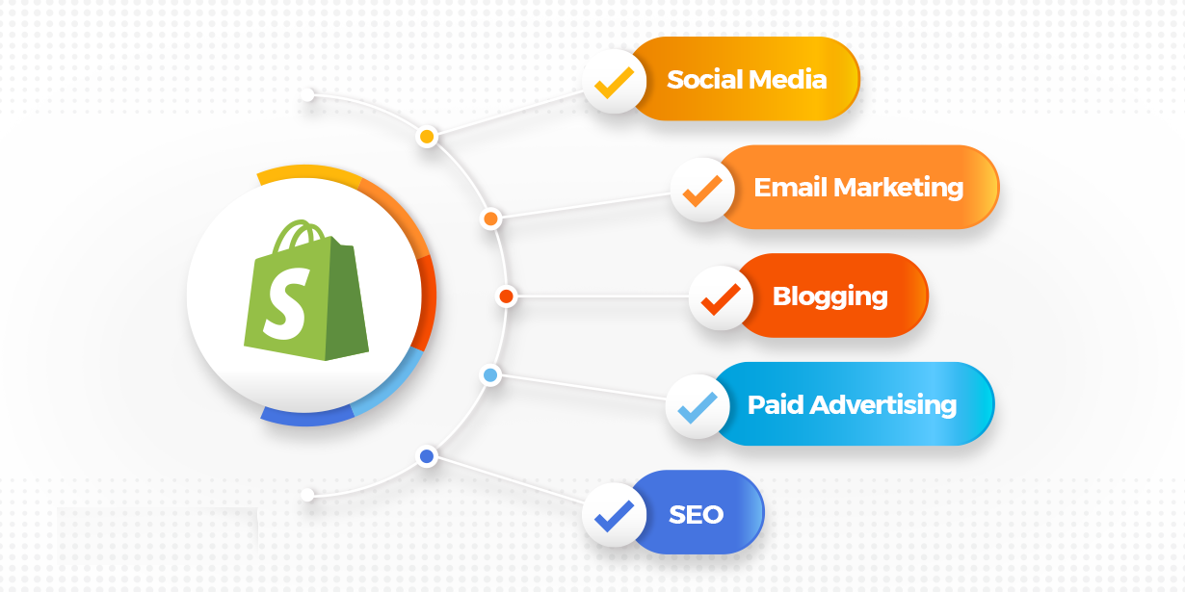
Product Descriptions and NLP:
To further refine recommendations, Shopify’s content-based filtering may use natural language processing (NLP) on product descriptions. If Anna previously viewed items described as “hydrating” and “antioxidant-rich,” then other products with similar keywords, such as Hydrating Antioxidant Mask, would also be recommended.
Session-Based Real-Time Recommendations:
While Anna is browsing, Shopify dynamically updates recommendations in real-time. For example, if she spends extra time on a “vegan moisturizer” page, the system might prioritize showing other vegan moisturizers or products with related attributes like “moisturizing” and “plant-based ingredients” in the “You May Also Like” section.

Slide 9
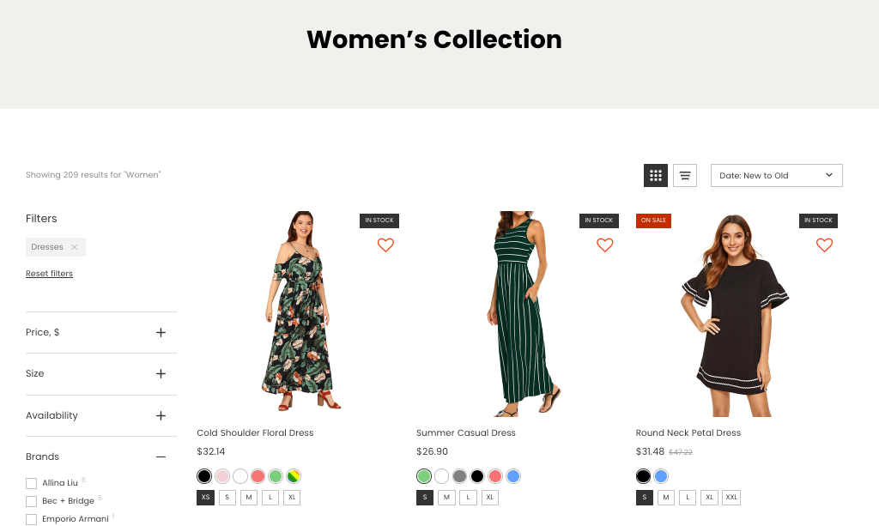
COLLEBORATIVE BASED FILTERING ON SHOPIFY
-> Collaborative filtering on Shopify involves recommending products based on user behavior patterns, leveraging the activities and preferences of similar users to provide personalized suggestions. Here’s a breakdown of how collaborative filtering can be applied in Shopify to enhance the customer shopping experience:
1. User-Based Collaborative Filtering
In this approach, Shopify recommends products based on what similar customers have viewed, added to their cart, or purchased.
Example: If User A frequently browses eco-friendly and sustainable products and purchases organic skincare, then User B, who has a similar browsing history or product preferences, may receive recommendations of products that User A also viewed or purchased, such as organic lotions or sustainable accessories.
Implementation: Shopify identifies clusters of users with similar behaviors using methods like K-Nearest Neighbors (KNN) or clustering algorithms. Products popular among users in one cluster are recommended to others within the same cluster.

Slide 10
2. Item-Based Collaborative Filtering
Shopify can recommend items that are frequently viewed or purchased together. This approach is particularly useful for cross-selling or upselling by analyzing purchase patterns and suggesting complementary products.
Example: If many customers who bought a specific yoga mat also purchased a matching water bottle and yoga blocks, then customers interested in that yoga mat will see recommendations for those accessories.
Implementation: Shopify uses item similarity metrics (like cosine similarity) to create a matrix showing which products are frequently associated. When a user views a product, Shopify recommends items with high similarity scores based on past customer behavior.
3. “Customers Who Bought This Also Bought” Recommendations
This classic collaborative filtering technique highlights products that customers commonly purchase together, which can appear on product pages or checkout.
Example: On the product page for a winter jacket, Shopify might show gloves, scarves, or hats that other customers have purchased alongside the jacket, encouraging the shopper to consider buying additional items for a complete look.
Implementation: Shopify generates this recommendation by mining transaction data and identifying frequently co-purchased products. This information is displayed to drive sales and increase average order value.
4. “People Also Viewed” Recommendations
This form of collaborative filtering displays products that users viewed in the same session or within a specific timeframe. It’s beneficial for showing alternatives or related products without being tied to purchase behavior.
Example: If many users who viewed a “stainless steel travel mug” also viewed other travel mugs or insulated bottles, Shopify can recommend these products under a “People Also Viewed” section.
Implementation: Shopify tracks product views across users and creates associations based on frequently co-viewed products, surfacing these recommendations for users browsing specific items.
. Session-Based Collaborative Filtering for Real-Time Recommendations
In session-based collaborative filtering, Shopify analyzes user behavior in real-time to offer immediate recommendations. This is particularly useful for users with limited historical data, such as new visitors.
Example: If a user is browsing a category like “minimalist home decor,” the system will prioritize recommendations of similar items within that category, reflecting trends seen in other users’ sessions.

Slide 11
HERE IS AN EXAMPLE OF COLLEBORATIVE BASED FILTERING
Example of Collaborative Filtering in Action on Shopify
Suppose a user, John, is shopping for electronics. Here’s how collaborative filtering would recommend items to him:
User-Based Recommendations:
Shopify identifies that John’s browsing and purchasing patterns align with other customers interested in gadgets and accessories. Based on similar users’ behavior, it recommends items like portable chargers, Bluetooth earphones, and smart home devices.
Item-Based Recommendations:
While browsing a smartphone, John sees a “Frequently Bought Together” section recommending phone cases, screen protectors, and wireless chargers. These are based on purchase data from other users who bought that smartphone.
Session-Based Recommendations:
In the same session, John views multiple items within the “smart devices” category. Shopify dynamically shows other trending smart devices, ensuring he sees a variety of products within his area of interest.

Slide 12
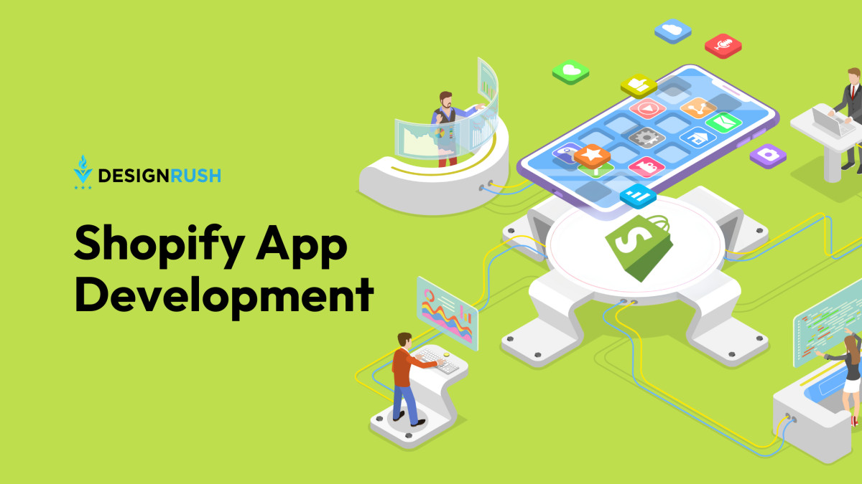
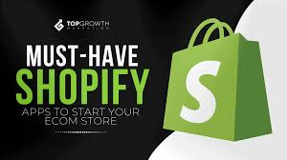
IMPLEMENTATION OF RECOMMENDER SYSTEM OF SHOPIFY APP
Implementing a recommender system on the Shopify app can significantly enhance personalization and customer experience by providing targeted product recommendations. The process involves defining recommendation goals, choosing the right algorithms, collecting and processing data, and implementing the system on Shopify’s platform. Here’s a step-by-step guide on how to implement a recommender system for a Shopify app:

Slide 13


